Slide 1

The Rendering Technologies of
Tiago Sousa | Carsten Wenzel | Chris Raine
R&D Principal Graphics Engineer | R&D Lead Software Engineer | R&D Senior Software Engineer
 | Crytek
Notes:
Hi everyone !
Welcome to “The Rendering Technologies of Crysis 3” – our latest game, which I’m sure you’ve heard, it has a lot of GRAPHICS !
My name is Tiago Sousa, I’m Cryteks R&D Principal Graphics Engineer. Unfortunately Carsten and Chris couldn’t be today with me on stage, but I’ll do my best to present some of their great work.
During past year we’ve made quite some multiplatform and DX11 related updates to our CryENGINE 3. I’ve picked 5 topics for you today, from some of these updates, that I hope you’ll like:
- Deferred Rendering
- Volumetric Fog
- Silhouette POM
- Massive Grass
- Anti-Aliasing
Each of the topic would deserve a separate and minucious lecture for itself, but I’ll try to share clearly the topics foundation/concepts from the work we did.
Before we start, heads up that I’m assuming most here familiar with CryENGINE 3 rendering, if not please check out our previous GDC/Siggraph/Gamefest talks after this lecture.
So, withouth further dues, lets quickly start – we have to cover a lot of ground !

Slide 2
Thin G-Buffer 2.0
For Crysis 3, wanted:
Minimize redundant drawcalls
AB details on G-Buffer with proper glossiness
Tons of vegetation => Deferred translucency
Multiplatform friendly
Notes:
Thin G-Buffer 2.0
The first topic we’ll cover is about deferred rendering, what changed here
For Crysis 3 there was 4 areas we wanted to improve:
Minimize redundant drawcalls. One big flaw from deferred lighting is the requirement for the additional shading drawcall, we wanted to get rid of this. Particularly important for MSAA support
Alpha blended details on G-Buffer (decals, deferred decals and similar) with proper glossiness. On crysis 2 (in case you didnt noticed) most decals had a fixed glossiness factor, we wanted art to be able to use nice gloss maps and such.
Tons of vegetation on screen – this means we needed to tackle somehow translucency for all deferred light types, including sun
Multiplatform friendly: Last but not least, Crysis 3 had the smallest fulltime tech development team ever (2 rendering guys in Frankfurt), so we aimed at generalized solution that either work on all platforms or just DX11 to minimize QA efforts

Slide 3
Thin G-Buffer 2.0
Channels |  |  |  | Format
Depth |  |  | AmbID, Decals | D24S8
N.x | N.y | Gloss, Zsign | Translucency | A8B8G8R8
Albedo Y | Albedo Cb,Cr | Specular Y | Per-Project | A8B8G8R8
Notes:
This was our final G-Buffer layout
Essentially 64bits mrt setup + 32 bits for zbuffer&stencil

Slide 4
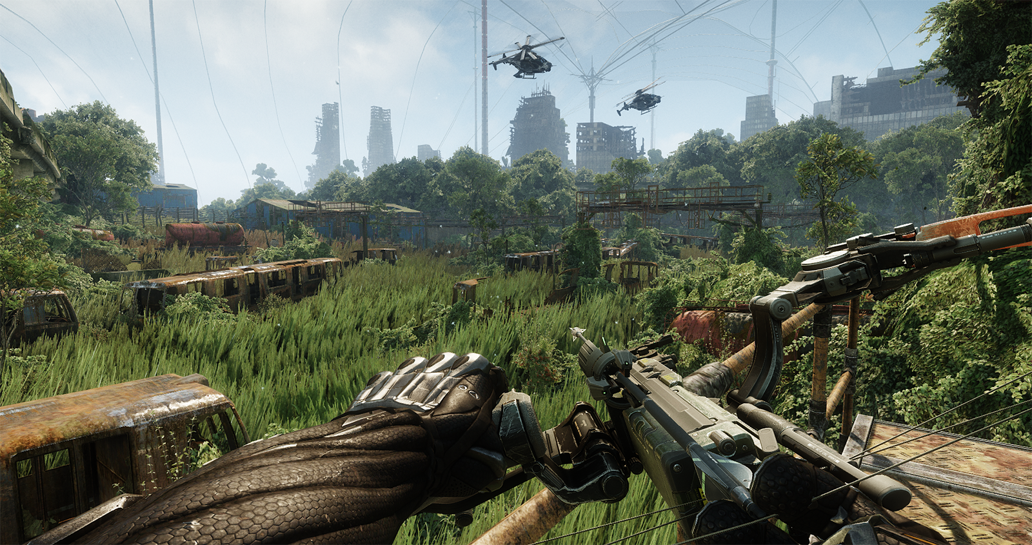
Target Image
Notes:
Let’s break it down into bits for easier visualization.
We start with our final target image, essentially everything is done (shadows, shading, tone mapping, etc)

Slide 5
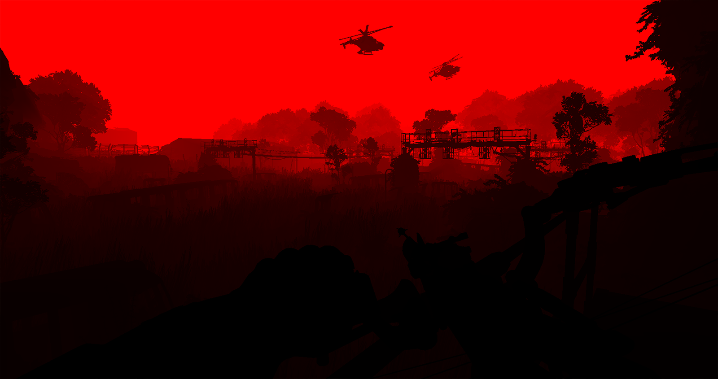
Depth
Notes:
Depth & Stencil
The usual
Only thing is for stencil we do some magic
1 bit is reserved to tag dynamic geometry (for masking out deferred decals – a real fix for deferred decals is tricky/expensive)
7 bits for tagging ambient areas, so that art can specify diferent ambient for some geometry (while avoiding leaking. We have couple diferent techniques for art convenience)

Slide 6
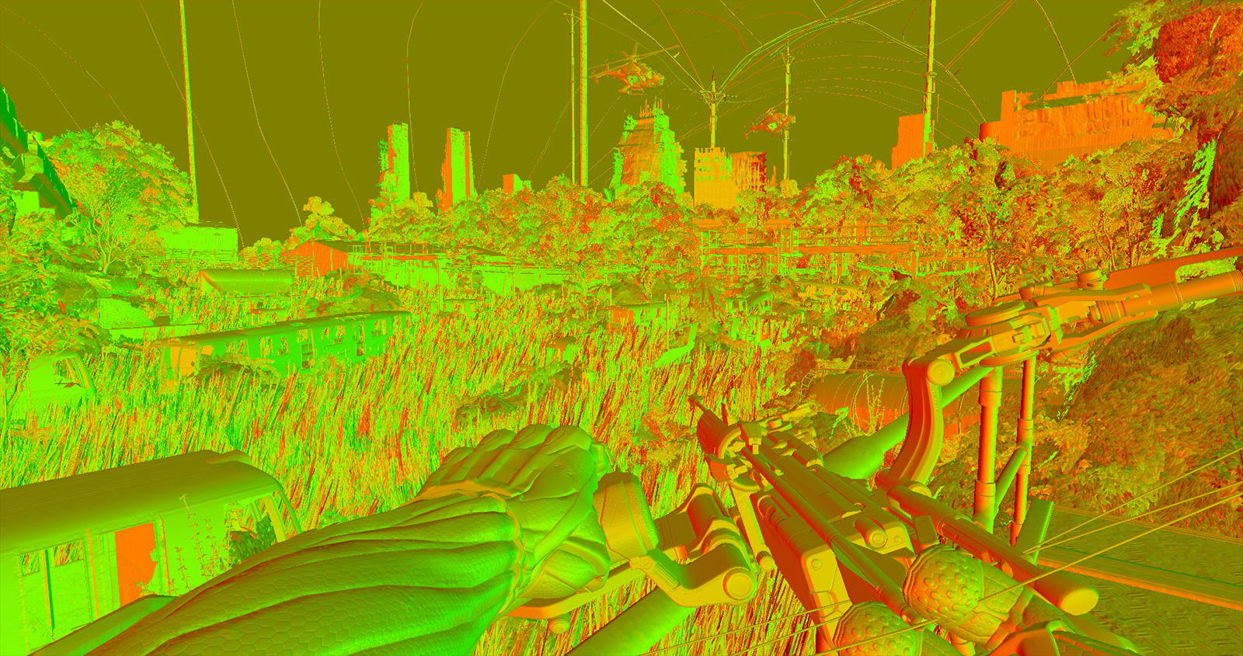
RG: Normals
Notes:
2 channels for world space normals storage

Slide 7
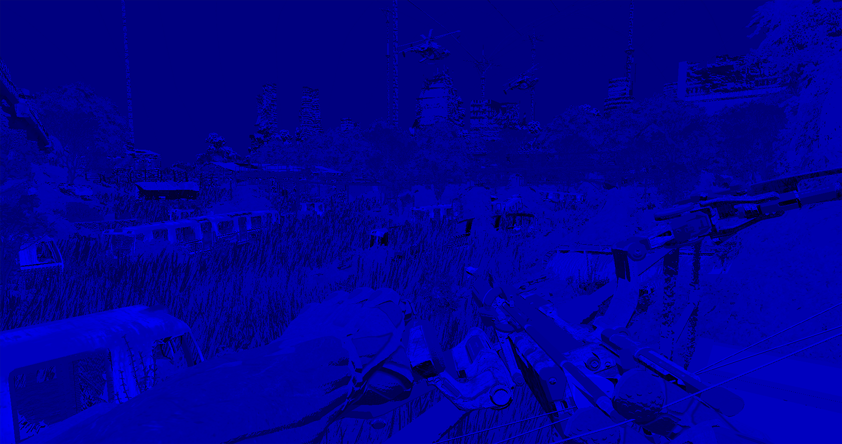
B: Glossiness

Slide 8
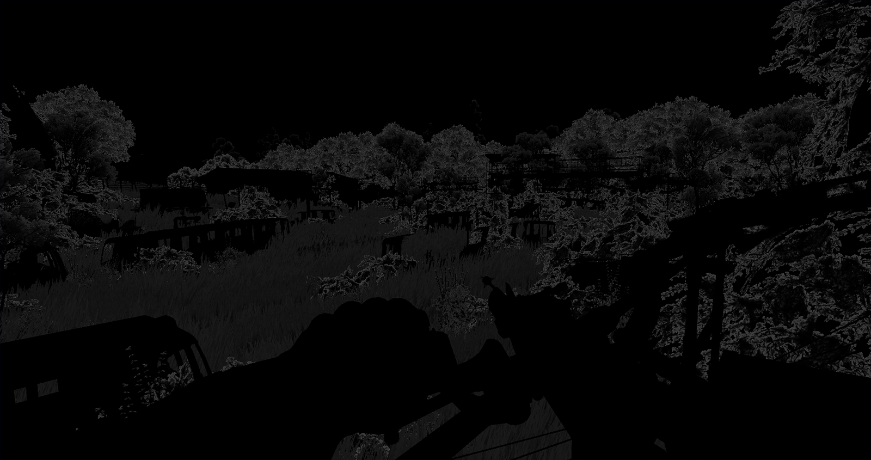
A: Translucency

Slide 9
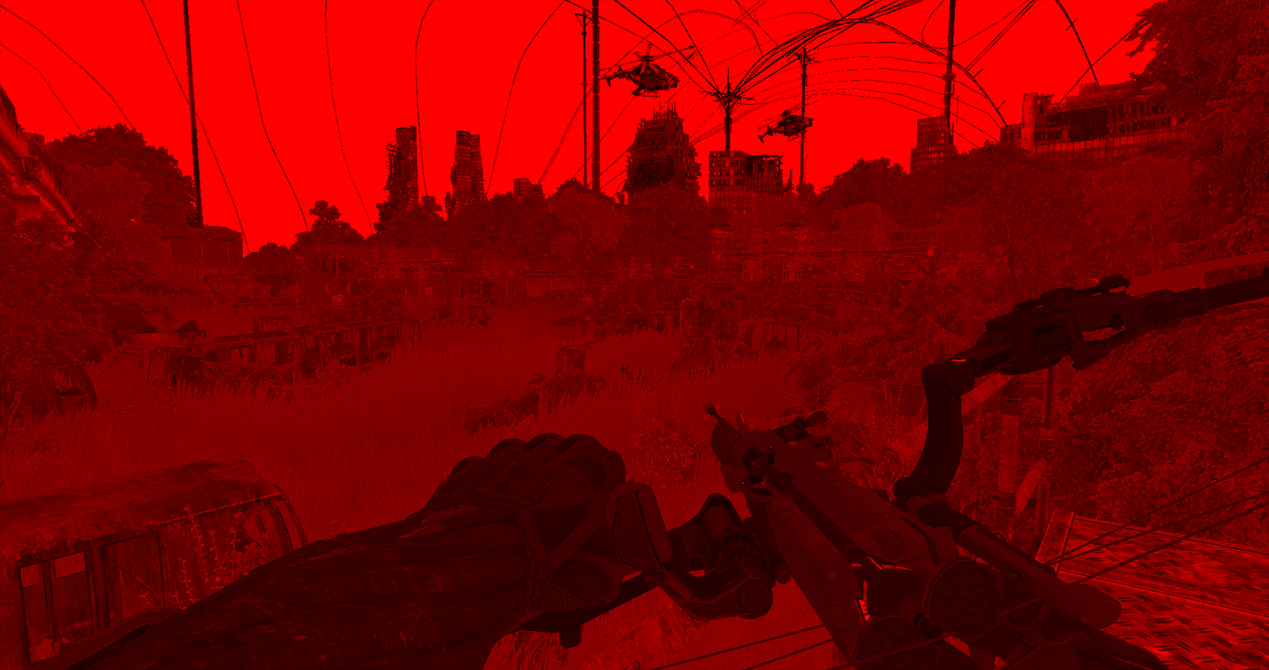
R: Albedo Y
Notes:
For the second target, we have additional material properties
On red channel, albedo luminance is stored

Slide 10

G: Albedo CbCr (interleaved)
Notes:
On green channel, albedo chrominance is stored, packed via chrominance subsampling – more details soon

Slide 11
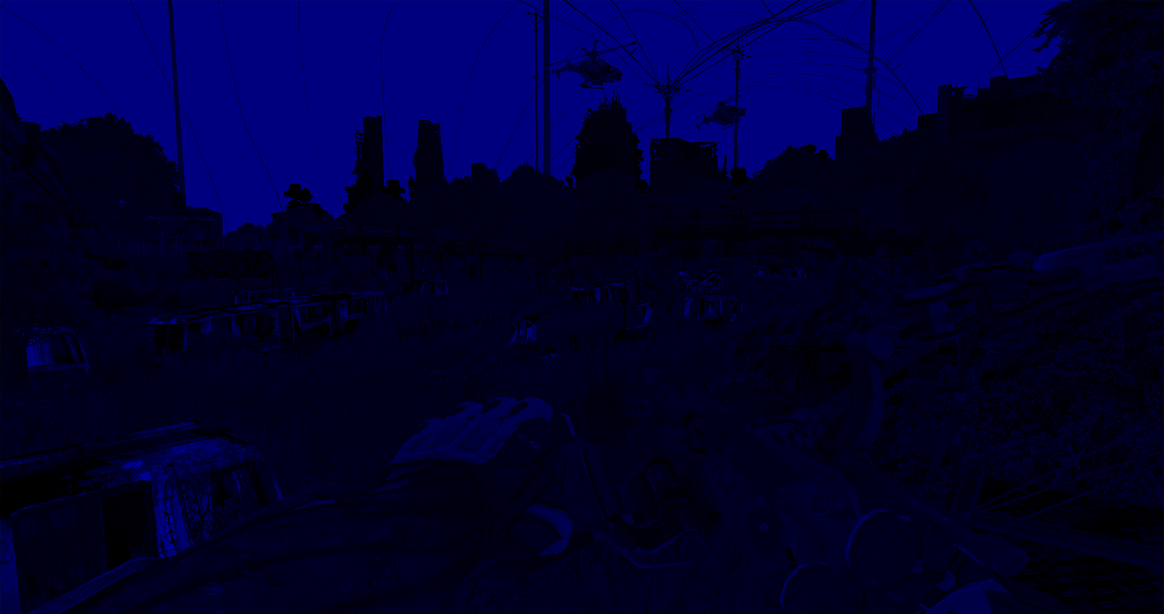
B: Specular intensity
Notes:
Blue channel stores specular intensity. As you know color for specular intensity is mostly needed just for certain metals – for us was an acceptable compromise

Slide 12
G-Buffer Packing
World space normal packed into 2 components (WIKI00)
Stereographic projection worked ok in practice (also cheap)
Glossiness + Normal Z sign packed together
Notes:
G-Buffer packing
As mentioned:
Normals are stored in 2 channels. Stereographic projection worked ok in practice, for us
We packed Z-sign together with 7 bits of glossiness
Important:
- This little tricks are what allowed us to have glossiness support for alpha blended cases and free 1 channel for storing translucency.

Slide 13
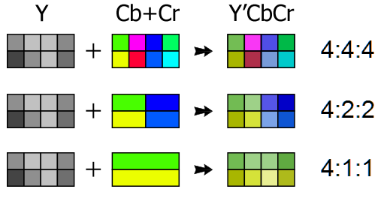
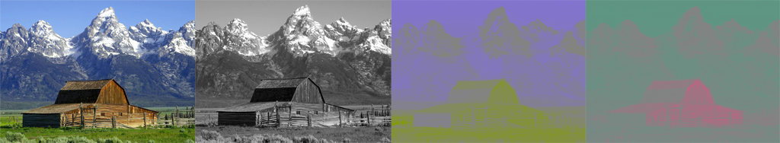
G-Buffer Packing (2)
Albedo in Y’CbCr color space (WIKI01)
Stored in 2 channels via Chrominance Subsampling (WIKI02)
Notes:
Albedo is stored using Y´CbCr color space. Might look quite some instructions, but it is actually fairly cheap in practice, couple ALUs
This is stored into 2 channels, via chrominance subsampling.
Important:
Concept here is that the Human Visual System has much lower accuity for color diferences. We actually are much better at checking luminance diferences
This means in practice we can store chrominance at lower frequency. Several packing schemes exist.

Slide 14
Hybrid Deferred Rendering
Deferred lighting still processed as usual (SOUSA11)
L-Buffers now using BW friendlier R11G11B10F formats
Precision was sufficient, since material properties not applied yet
Deferred shading composited via fullscreen pass
For more complex shading such as Hair or Skin, process forward passes
Allowed us to drop almost all opaque forward passes
Less Drawcalls, but G-Buffer passes now with higher cost
Fast Double-Z Prepass for some of the closest geometry helps slightly
Overall was nice win, on all platforms*
Notes:
Hybrid Deferred Rendering
This is an old idea from beggining of Crysis 2 times (way back to 2008), but back then we didn’t noticed much benefits, likely due to much simpler levels
Important:
Concept here is to use deferred rendering for everything that is “deferred compatible”, the rest is still processed using forward rendering
Step by step:
Deferred lighting accumulation still processed as usual (SOUSA11 - Sousa, T. “CryENGINE 3 Rendering Techniques”, 2011)
L-Buffers now using BW friendly R11G11B10F formats. Consoles still same formats
Precision was sufficient, materials properties are not applied yet – you need the precision mostly when applying material properties.
Deferred Shading composited via fullscreen pass
This is where material properties applied, still uses R16G16B16A16F format. In theory could use lower precision + range scalling has we do on consoles (didn’t try)
For more complex shading such as Hair or Skin, still process forward
Allowed drop of almost all opaque forward passes
Less Drawcalls, but G-Buffer passes with higher cos
Z-Prepass for few nearest geometry
Important:
*Up to 10 ms on consoles on fairly heavy scenes, also fairly nice win for MSAA (regular deferred lighting + MSAA work fairly poor togheter)

Slide 15
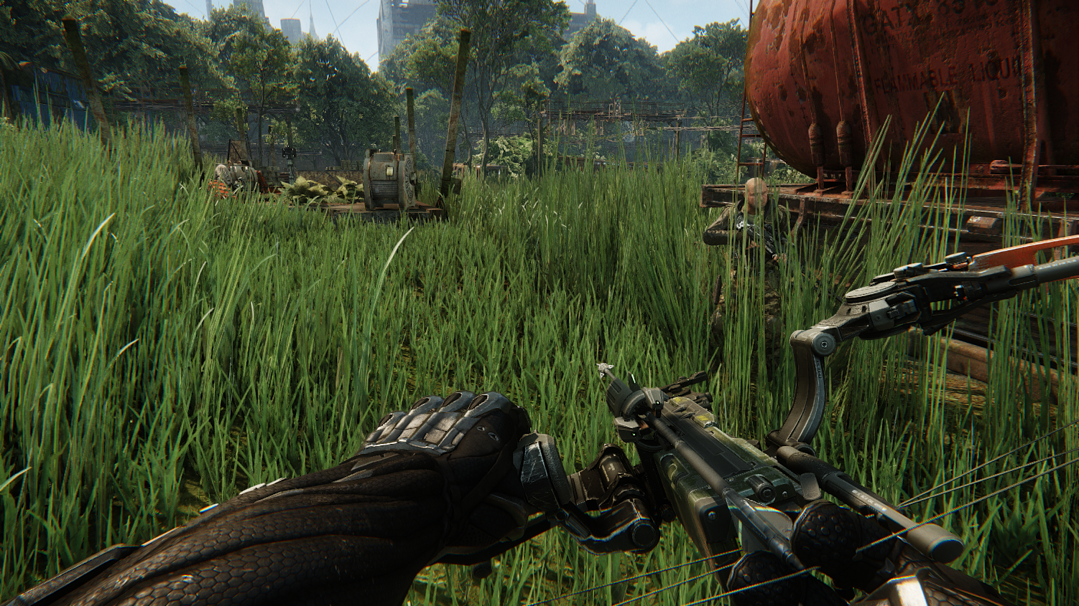
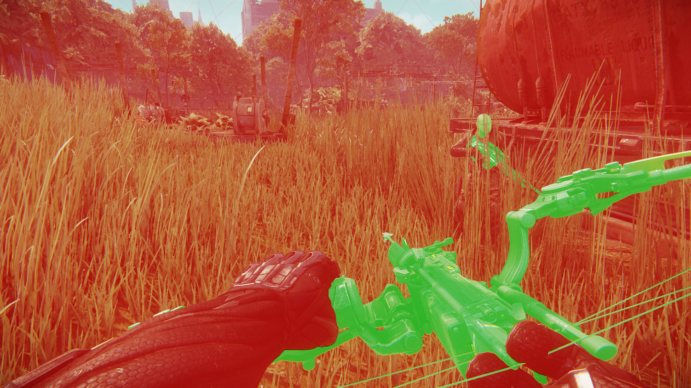
Hybrid Deferred Rendering (2)
Deferred (Red) + Forward (Green)
Notes:
Here we can see behaviour, red is for all pixels processed via deferred, green for all pixels still foward rendered

Slide 16
Thin G-Buffer Benefits
Unified solution across all platforms
Deferred Rendering for less BW/Memory than vanilla
Good for MSAA + avoiding tiled rendering on Xbox360
Tackle glossiness for transparent geometry on G-Buffer
Alpha blended cases, e.g. Decals, Deferred Decals, Terrain Layers
Can composite all such cases directly into G-Buffer
Avoid need for multipass
Deferred sub-surface scattering
Visual + performance win, in particular for vegetation rendering
Notes:
To recap what was said:
Unified solution for all platforms
Deferred rendering using 25% less BW than vanilla deferred. Good for MSAA /avoiding tiled rendering for xbox360
Allows tackle glossiness for transparent geometry on g-buffer and also sub surface scattering for all deferred lights

Slide 17
Thin G-Buffer Hindsights
Why not pack G-Buffer directly?
Because we need to be able to blend details into G-Buffer
Would need to decode –> blend –> encode
Or could blend such cases into separate targets (bad for MSAA/Consoles)
Programmable blending would have been nice
Transparent cases can’t use alpha channel for store*
sRGB output only for couple channels or all
Would allow for more interesting and optimal packing schemes
While at it, stencil write from fragment shader would also be handy
Notes:
Thin G-Buffer Hindsights:
Why not pack G-Buffer directly into a 64 bit target ?
Because we need to be able to blend details into G-Buffer
Would need to decode –> blend –> encode
Or could blend such cases into separate targets (bad for MSAA/Consoles)
Programable blending would have been nice
AB cases can’t use alpha channel for store (for all MRTs!)
*Withouth resorting to multipass
Would allow for more interesting and optimal packing schemes
sRGB output only for couple channels or all
While at it, stencil write from fragment shader would also be handy

Slide 18
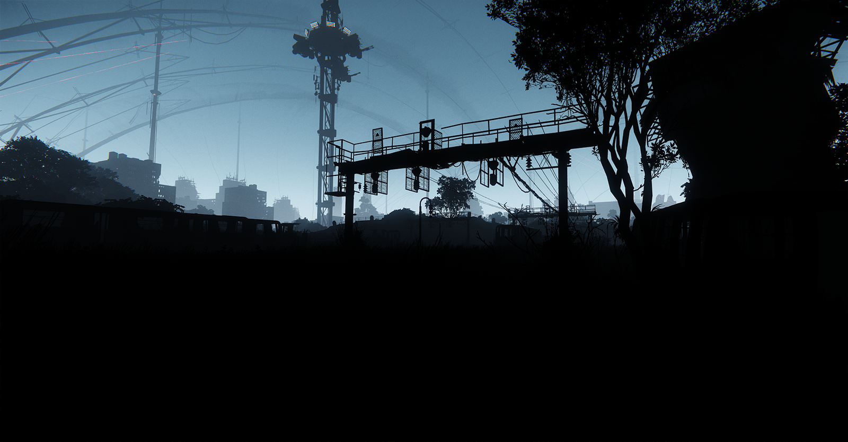
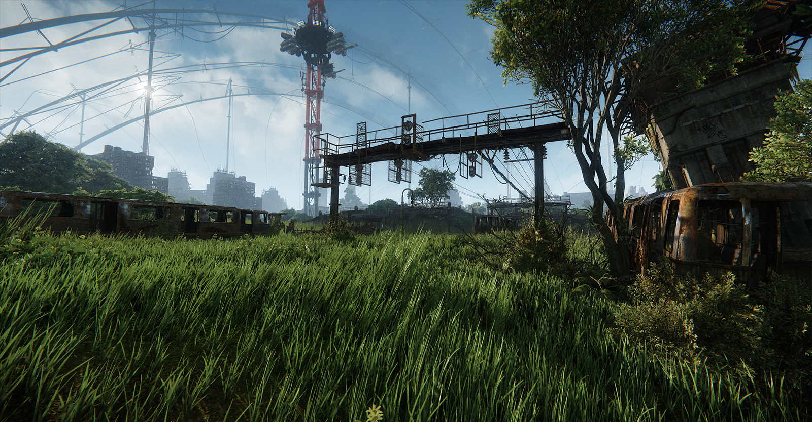
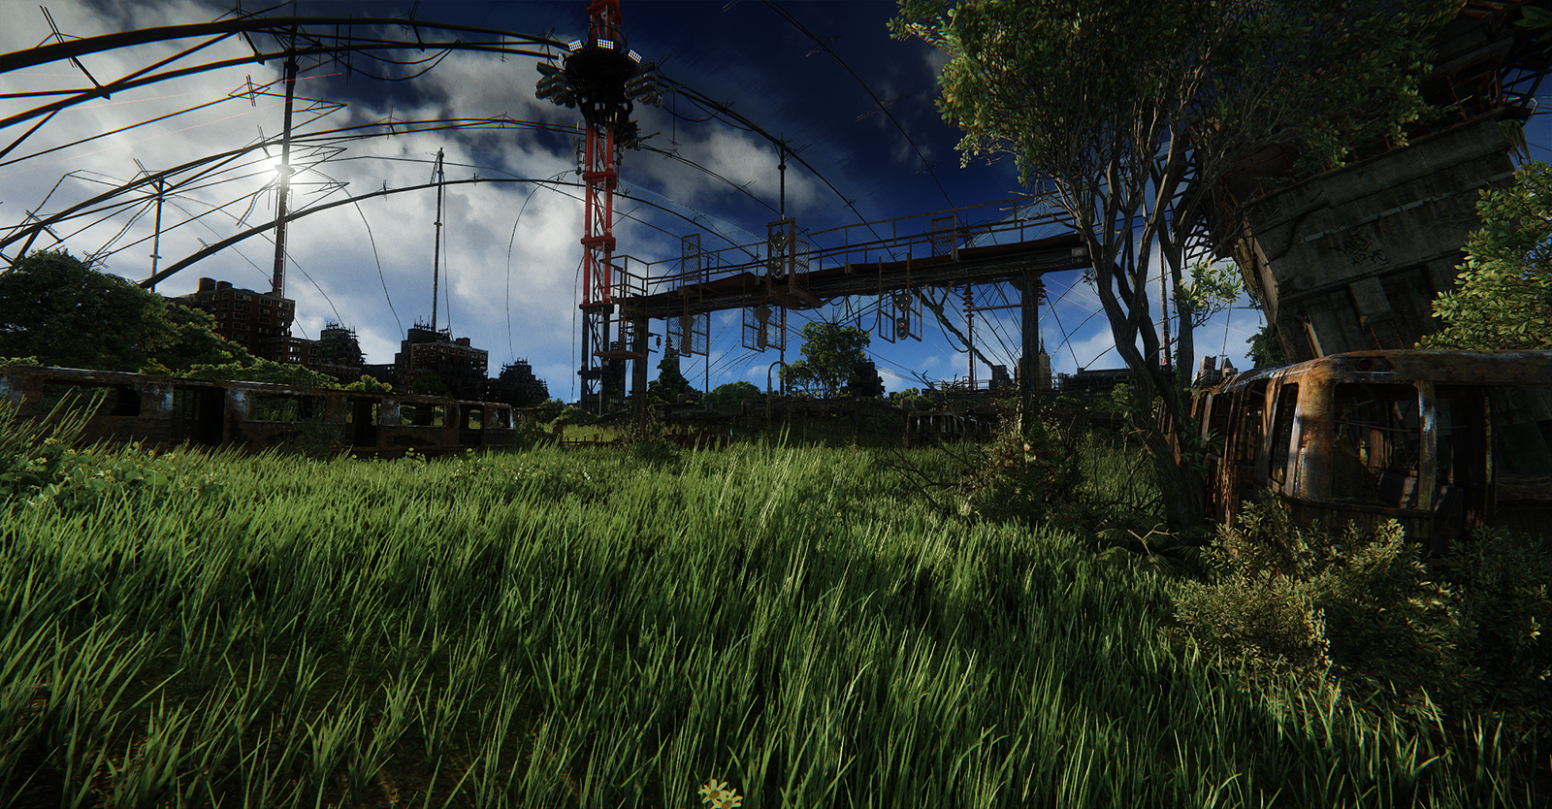
Volumetric Fog Updates
Density calculation based on fog model established for Crysis 1 (WENZEL06)
Deferred pass for opaque geometry
Per-Vertex approximation for transparent geometry
Notes:
Volumetric Fog Updates:
Mostly same since Crysis 1 times, with couple updates
Fog density calculation still same model that Carsten introduces in his “Real Time Atmospheric Effects in Games”, in 2006
Still rendered in deferred fashion as fullscreen pass for opaque geometry. One little optimization here was computing distance at which fog contributes or not at all and set minZ accordingly for Depth bounds checking (you could also achieve same by rendering quad at such depth + depth test)
For transparents, we still do a per vertex approximation, unless is some visually important/low tessellation case such as water, for such we compute it per-pixel

Slide 19
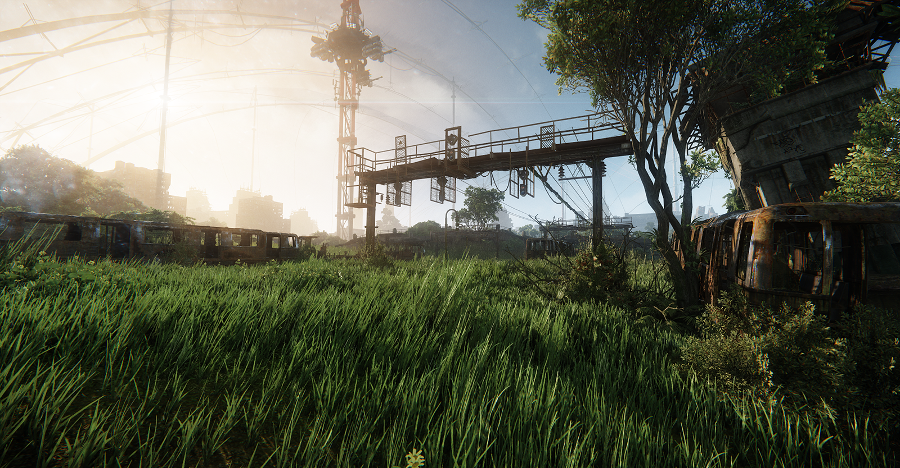
Volumetric Fog Updates
Little tuning: Artist controllable gradients (via ToD tool)
Height based: Density and color for specified top and bottom height
Radial based: Size, color and lobe around sun position
Notes:
One update we made, was exposing artist controleable gradients
. Height based gradients allow controlling color and density for top and minimum height
. The radial gradient allows art to control color/size/and lobe around sun position.
Not super physically based, but was one of those things art kept requesting for artistic control

Slide 20
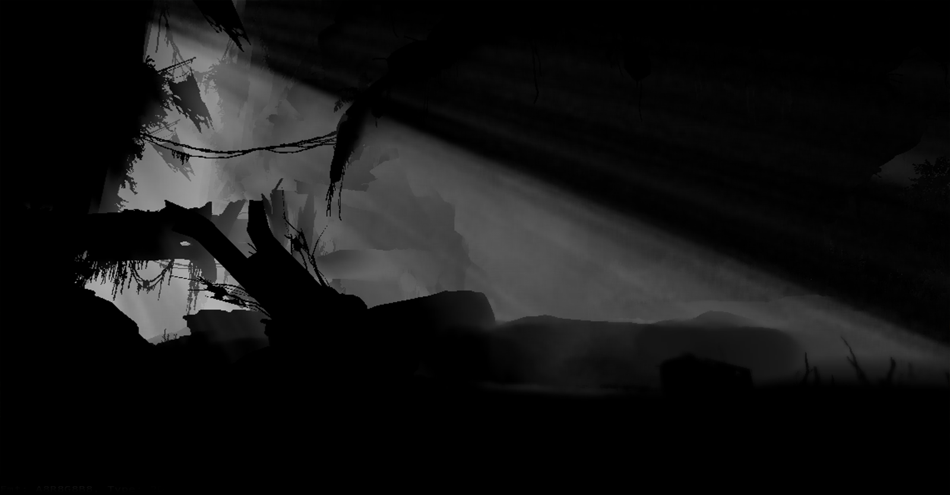
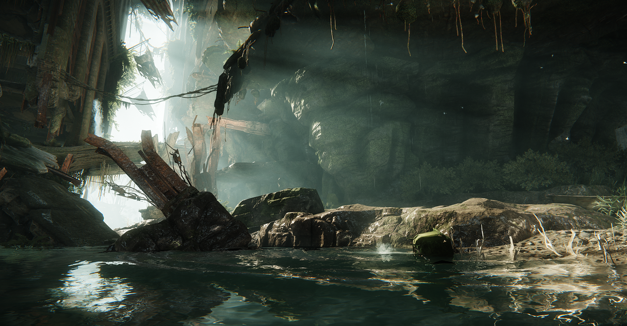
Volumetric Fog Shadows
Based on TÓTH09: Don’t accumulate in-scattered light but shadow contribution along view ray instead
Notes:
Volumetric Fog Shadows
Something new we introduced for Crysis 3
. Our work is based on “Real Time Volumetric Lighting in Participating Media”, by TOTH et al in 2009
Important
. Concept here is to not accumulate in-scattered light, we only accumulate shadow contribution along view ray
. Fairly simple, imagine you have a volume, discretize it, say divide in 16 points, check if for each point, sample shadow map if its in shadow at that location or not

Slide 21
Volumetric fog shadows
Interleave pass distributes 1024 shadow samples on a 8x8 grid shared by neighboring pixels
Half resolution destination target
Gather pass computes final shadow value
Bilateral filtering was used to minimize ghosting and halos
Shadow stored in alpha, 8 bit depth in red channel
Used 8 taps to compare against center full resolution depth
Max sample distance configurable (~150-200m in C3 levels)
Cloud shadow texture baked into final result
Final result modifies fog height and radial color
Notes:
Technique is fairly simple:
We interleave 1k samples on a 8x8 grid, so for each pixel we use 16 taps. This is done of course at half resolution
Then a fullscreen composite pass for computing final shadow value.
Bilateral filtering was used to minimize artifacts
On our case, we used 8 taps from a low resolution depth buffer to compare with full resolution depth.
All data for composite step stored on same target. 8 bit precision for depth sufficed to tackle most obvious artifacts.
Extra:
Max sample distance configurable (~150-200m in C3 levels)
Cloud shadow texture baked into final result
Final result modifies height and radial color components of fog

Slide 22
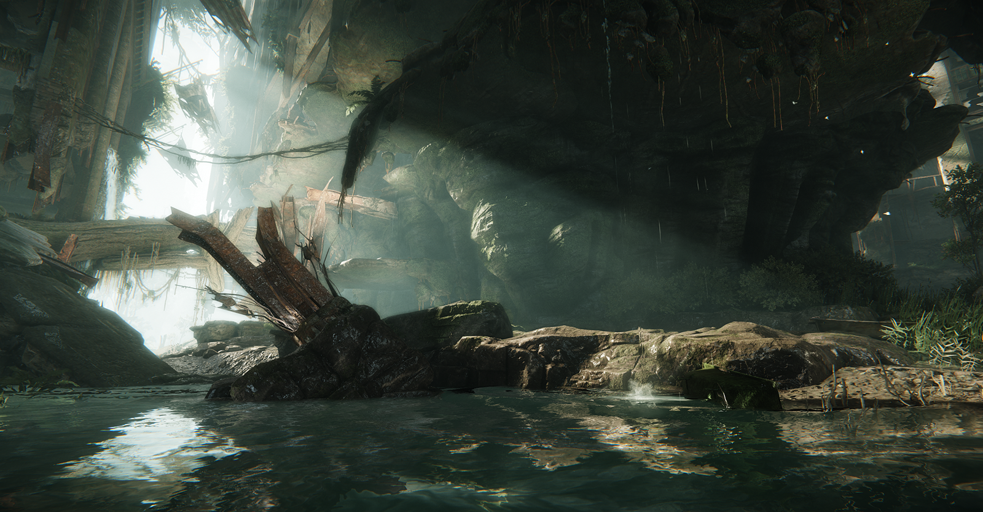
Naive Upscale

Slide 23

Bilateral Upscale

Slide 24
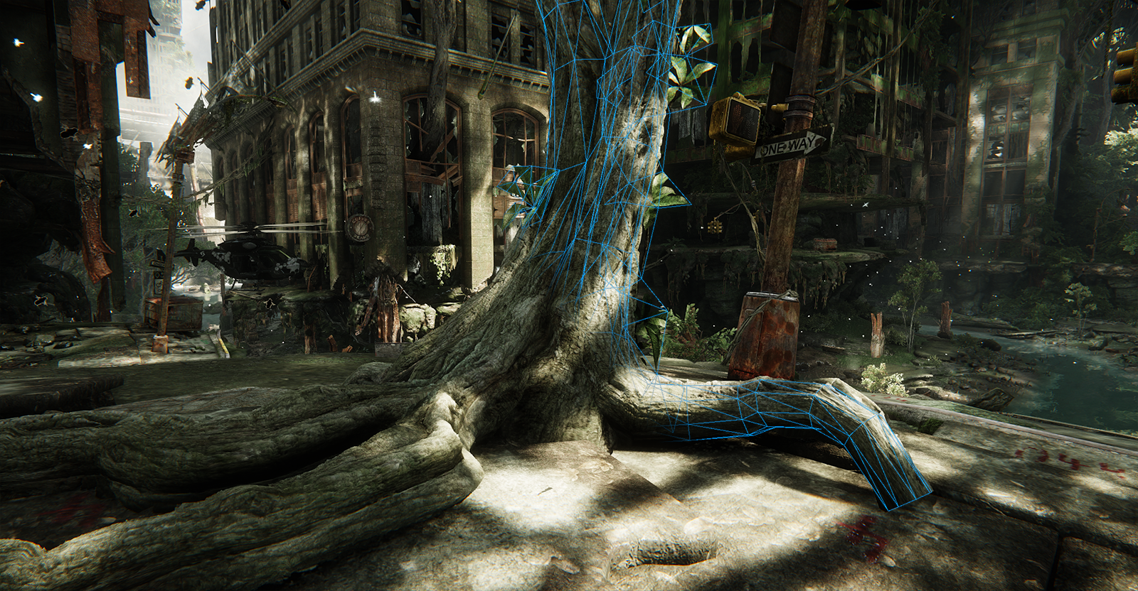
Silhouette POM
Notes:
Alternative to tessellation based displacement mapping
Looked into various approaches, most weren’t practical for production
Current implementation is based on principle of barycentric correspondence introduced (afawk) by JESCHKE07 - Jeschke, S. et al. “Interactive Smooth and Curved Shell Mapping”, 2007

Slide 25
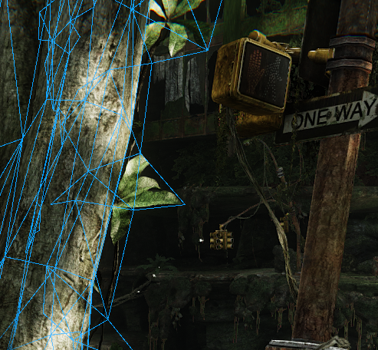
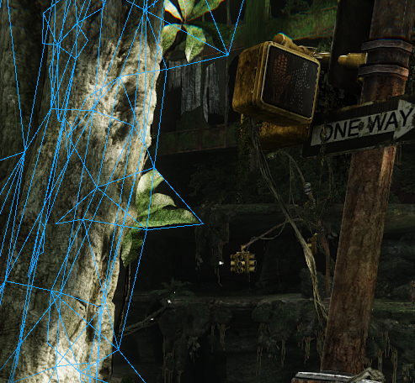
Silhouette POM
Alternative to tessellation based displacement mapping
Looked into various approaches, most weren’t practical for production
Current implementation is based on principle of barycentric correspondence (JESCHKE07)
Notes:
JESCHKE07 - Jeschke, S. et al. “Interactive Smooth and Curved Shell Mapping”, 2007
Alternative to tessellation based displacement mapping
Looked into various approaches, most weren’t practical for production
e.g. needed obj space normal maps, separate shader for fins and shells, very expensive ray prism intersection costs, etc
Current implementation is based on principle of barycentric correspondence (JES07)
Allows tracing ray in obj space and map it back into texture space

Slide 26
Silhouette POM: Steps
Transform vertices and extrude - VS
Generate prisms (do not split into tetrahedral) and setup clip planes - GS
Generally prism sides are bilinear patches, we approximate by a conservative plane
Note to IHVs: Emitting per-triangle constants would be nice!
In theory, on DX11.1, we could emit via UAV output?
Ray marching - PS
Compute intersection of view ray with prism in WS, translate to texture space via (Jeschke07) barycentric correspondence
Use resulting texture uv and height for entry and exit to trace height field
Compute final uv and selectively discard pixel (viewer below height map; view ray leaving prism before hitting terrain)
Lots of pressure on PS, yet GS is the bottleneck (prism gen)
Notes:
Transform vertices and extrude – VS
Output current vertex + extruded version (position, view vector)
Generate prisms (do not split into tetrahedral) and setup clip planes - GS
Generally prism sides are bilinear patches, we approximate by a conservative plane
Note to IHVs: Emitting per-triangle constants would be nice!
Ray marching - PS
Compute intersection of view ray with prism in WS, translate to texture space via barycentric correspondence
Use resulting texture uv and height for entry and exit to trace height field
Compute final uv and selectively discard pixel (viewer below height map; view ray leaving prism before hitting terrain)
Lots of pressure on PS, yet GS is the bottleneck (prism gen)

Slide 27
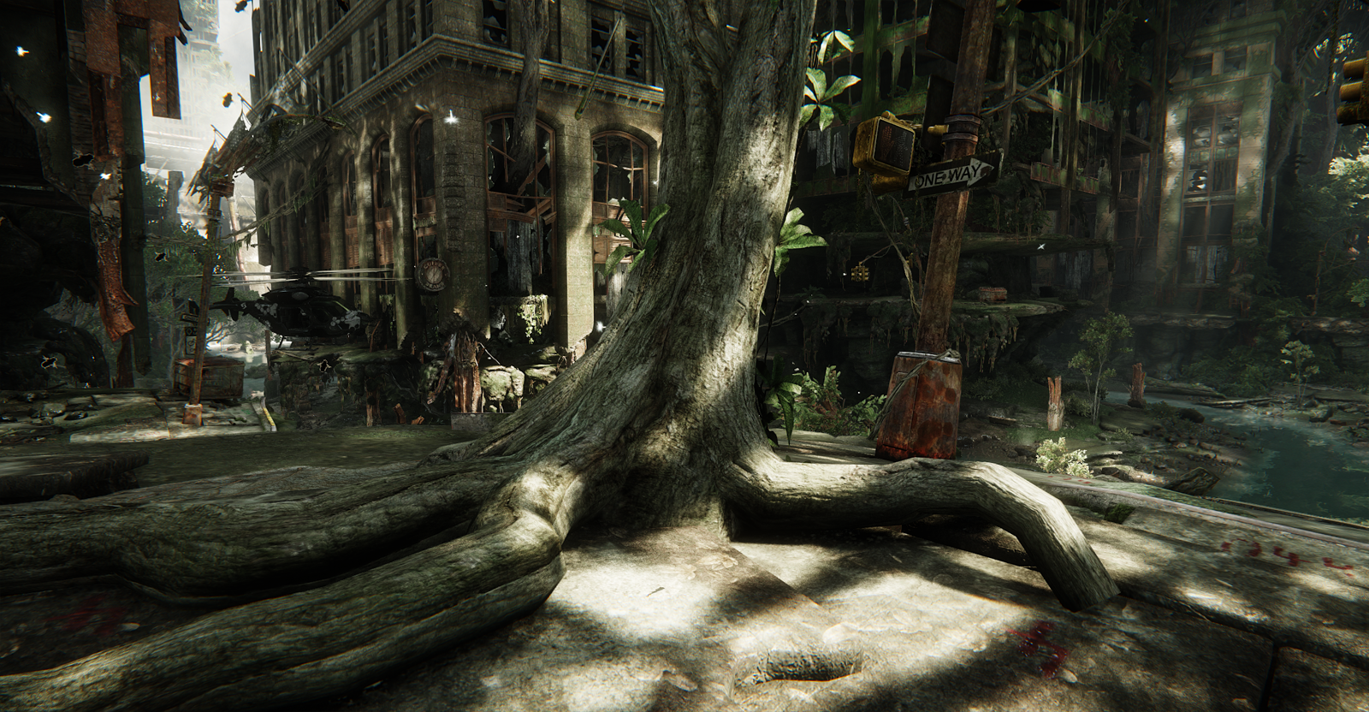
Silhouette POM

Slide 28
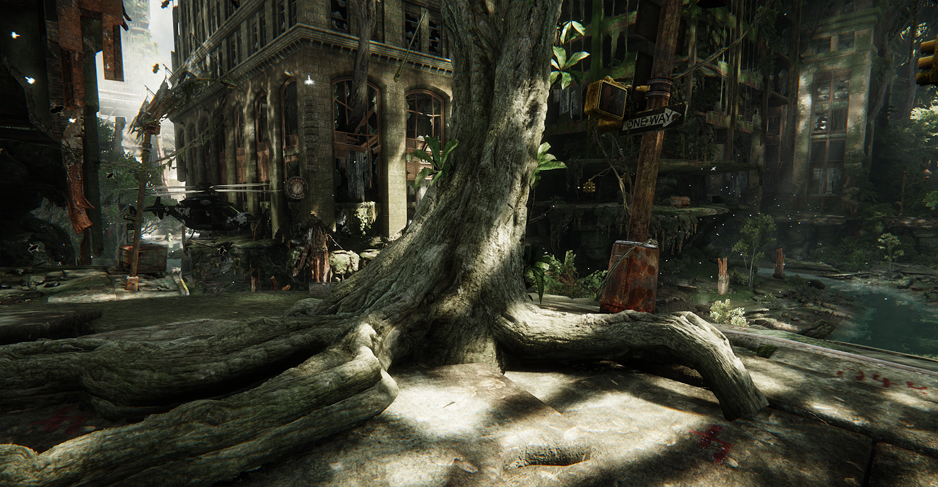
Silhouette POM
Notes:
Currently don’t fix up depth buffer for correct intersections
Do fix up depth in separate target though which is used for deferred passes (shadows, fog, deferred decals, screen space occlusion, etc)
Uses same self shadow algorithm that also runs atop of OBM and POM
Next projects will make better usage of such tech ☺

Slide 29
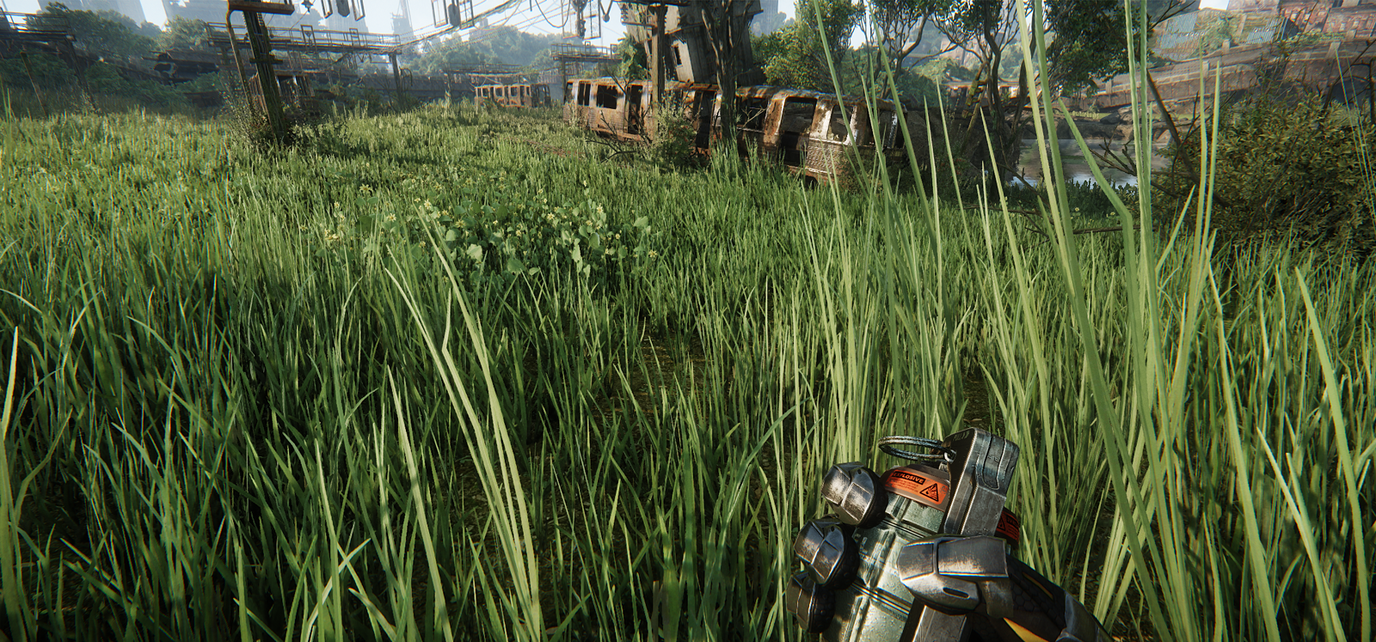
Massive Grass
Notes:
Initial goals: Everything moving on the screen: eg: grass, vegetation, cloth

Slide 30
Massive Grass: Simulation
Grass blade instance:
A chain of points held together by constraints
Distance + bending constrains to try maintain local space rest pose angle per-particle
Physics collision geometry converted into small sphere set
Collisions handled as plane constrains
No stable collision handling, overdamp the instance
Applied to vegetation meshes via software-skinning
Exposed parameters per group:
Stiffness, damping, wind force factor, random variance

Slide 31
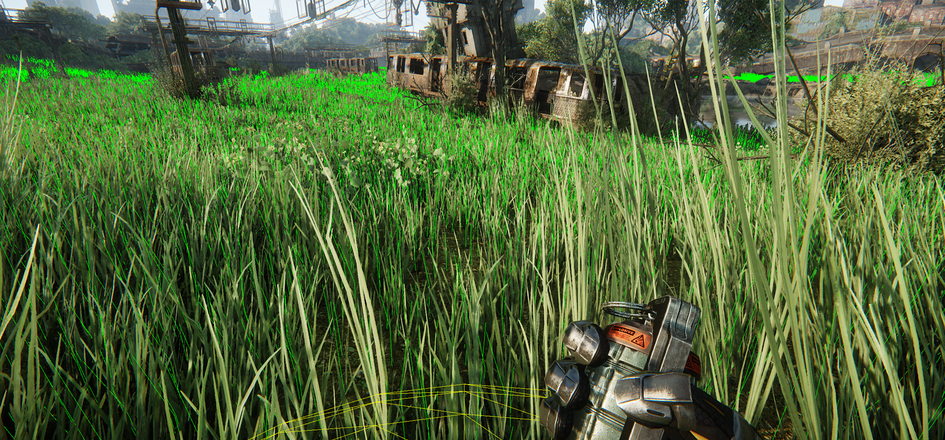
Massive Grass: Simulation

Slide 32
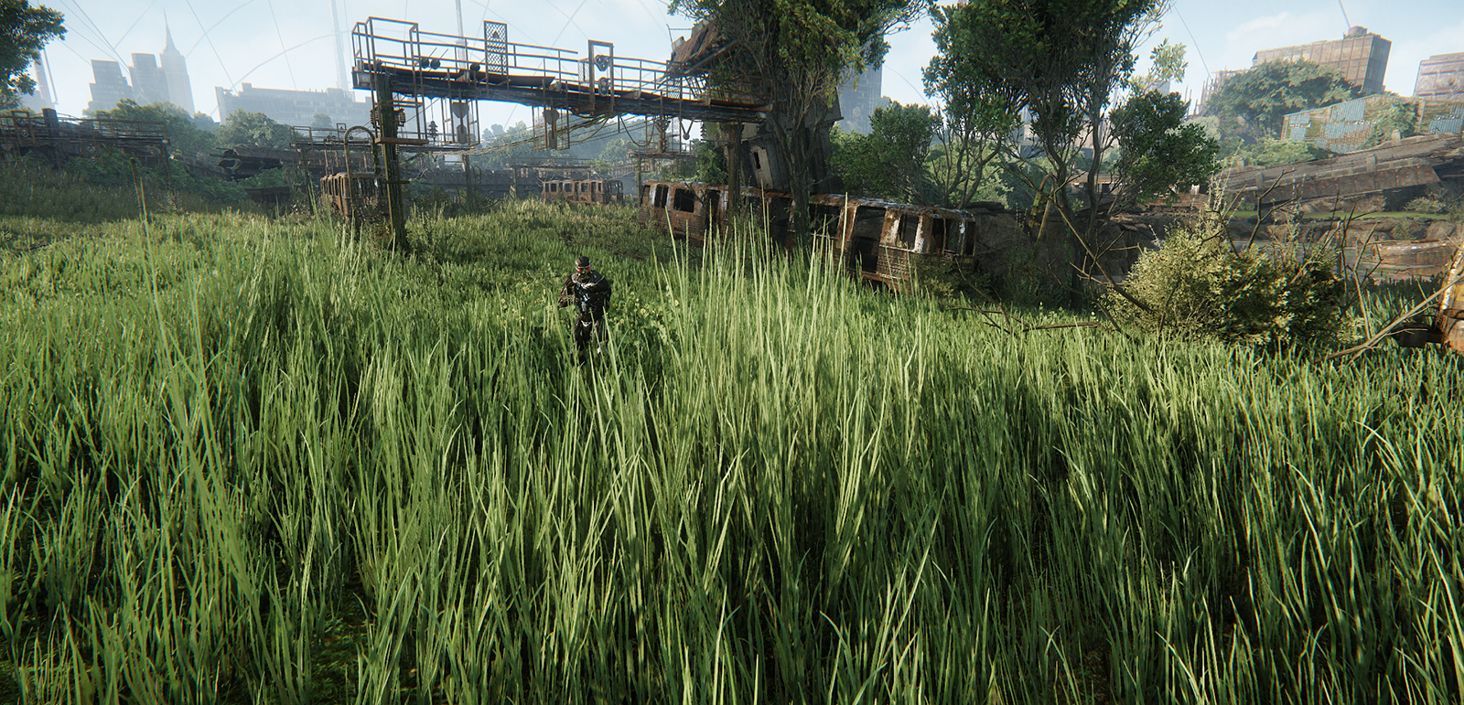
Massive Grass: Simulation

Slide 33
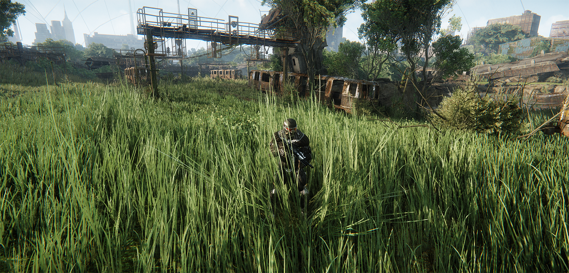
Massive Grass: Simulation

Slide 34
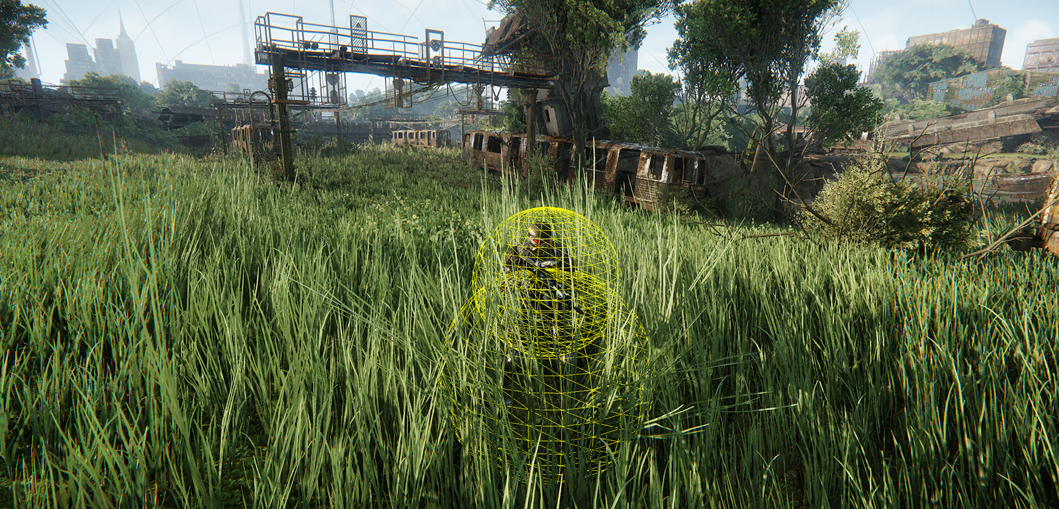
Massive Grass: Simulation

Slide 35
Massive Grass: Mesh Merging
One patch results in N-Meshes
N is number of materials used
Instances grouped into 16x16x16 meter patches (yes, volumetric)
Typical Numbers:
50k – 70k visible instances on consoles. PC > 100k
Instances have 18 to 3.6k vertices depending on mesh complexity
Closest instances simulated every frame
Based on distance: simulation and time sliced skinning
Instances removed further away

Slide 36
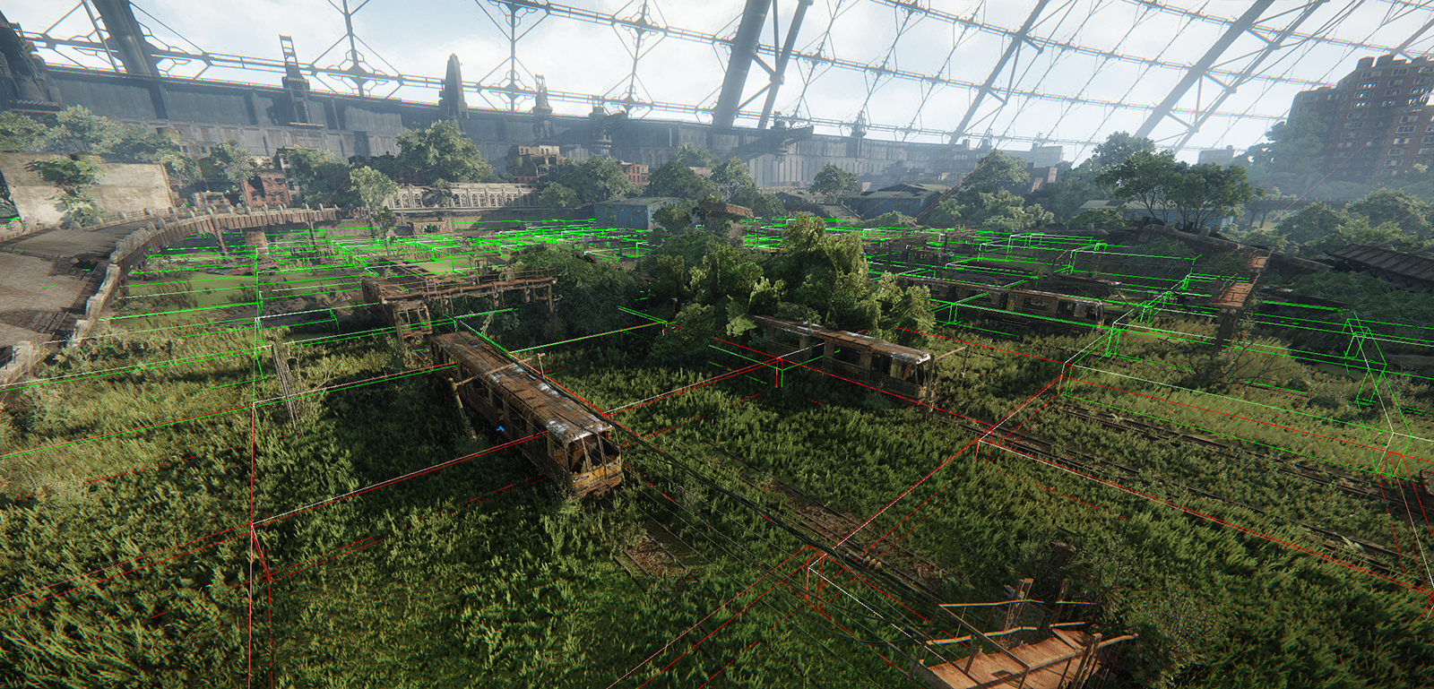
Massive Grass: Mesh Merging
Notes:
Red simulated everyframe/ highest detail. Green time sliced update/lower detail (no shadows and such)

Slide 37
Massive Grass: Update Loop
Culling process (for each visible patch):
Mark visible instances
Compute LOD
Check if instance should be skipped in distance
After culling:
Allocate (from pool) dynamic VB/IB memory for each patch
Sample force fields into per-patch buffer (coarse discretization 4x4x4)
Sample physics for potential colliders, extract collider geometry
Dispatch sim & skin jobs for each patch

Slide 38
Massive Grass: Challenges
Efficient buffer management
Resulting meshes can vary in size per frame
Naive implementation (C2) resulted in bad perf on PC and out of vram on consoles due to fragmentation
Current implementation inspired by “Don’t Throw it all Away” (McDONALD12)
Large pools for dynamic IB/VB
Each maintains two free lists (usable and pending)
Each item in pending list is moved to main free list as soon as GPU query guarantees GPU done with pool
1.3 MB consoles main memory and PC 16 MB
Notes:
MCD12 – McDonald, J. “Don’t Throw it all Away”, 2012
Efficient buffer management
Resulting meshes can vary in size per frame. Eg: player walking/looking diferent directions can result in more/less vegetation visible
Large pools for dynamic IB/VB
Each maintains two free lists (usable and pending)
Each item in pending list is moved to main free list as soon as GPU query guarantees GPU done with pool * (done with rendering)

Slide 39
Massive Grass: Challenges (2)
Efficient scheduling:
Patch instances are divided into small groups
Sim job kicked off for each group in main thread
DP in render thread has blocking wait for sim job
Job considered low-priority
Important:
Avoid unnecessary copies, skin directly to final destination
Reduce throughput and memory requirements (used half & fixed point precision everywhere)
PC: ~15 ms, 300 to 600 jobs on worst case scenarios
Xbox360 ~16ms, 800 jobs; PS3 ~10ms, 100-400 jobs
Notes:
Efficient scheduling:
Patch instances are divided into small groups
Sim job kicked off for each group in main thread
DP in render thread has blocking wait for sim job (gives full frame of time)
Job considered low-priority (= higher priority jobs run before it in work queue)
*No copies at all, store directly
Important:
Avoid unnecessary copies, skin directly to final destination
Reduce throughput and memory requirements (used half & fixed point precision everywhere)* e.g.: velocity for sim

Slide 40
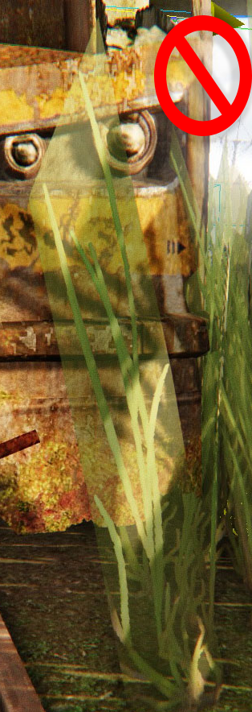
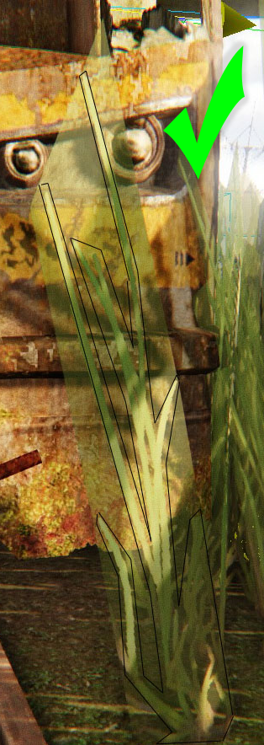
Massive Grass: Challenges (3)
Alpha tested geometry, literaly everywhere
Massive overdraw, also troublesome for MSAA
Literaly worst case scenario for RSX due to poor z-cull
Prototyped alternatives (e.g. geometry based)
Art was not happy with these unfortunately
End solution: keep it simple
G-Buffer stage minimalistic
Consoles: Mostly outputting vertex data
Art side surface coverage minimization
Notes:
Alpha tested geometry. Literaly everywhere
Worst case scenario for RSX due to fairly poor z-cull. Xbox 360 outperformed PS3 here 2x.
Also troublesome for MSAA
Prototyped alternatives (e.g geometry based) but art hated them
End solution: keep it simple
G-Buffer stage minimalistic
Consoles: Mostly outputting vertex data
Surface coverage minimize
1 cycle fragment program on rsx + extra cycle due to clip requirement

Slide 41
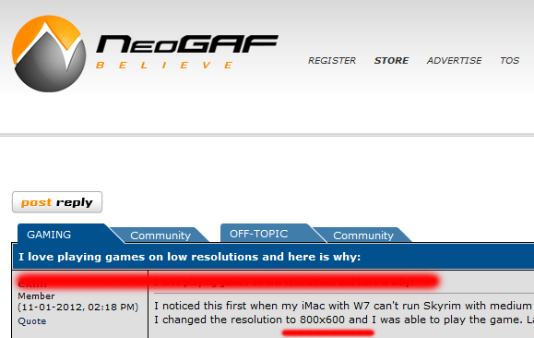
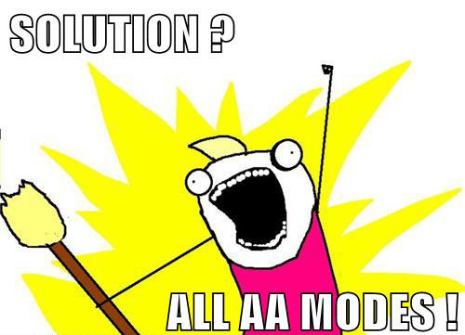
Anti-aliasing
Subjective topic: Sharp VS Blurry
Some PC gamers hate blurry, some hate sharp.
Some even love 800x600 and no AA
Notes:
Just gave a combo of options; let gamers pick their favorite

Slide 42
DX11 Deferred MSAA: 101
The problem:
Multiple passes and reading/writing from Multisampled Render Targets
SV_SampleIndex / SV_Coverage system value semantics allow to solve via multipass for pixel/sample frequency passes (Thibieroz08)
SV_SampleIndex
Forces pixel shader execution for each sub-sample
SV_SampleIndex provides index of the sub-sample currently executed
Index can be used to fetch sub-sample from your Multisampled RT
E.g. FooMS.Load( UnnormScreenCoord, nCurrSample)
SV_Coverage
Indicates to pixel shader which sub-samples covered during raster stage
Can also modify sub-sample coverage for custom coverage mask
Notes:
*alpha tested geometry included
*custom coverage mask allows for nifty tricks: e.g. Selective alpha test Super-Sampling, custom ATOC, fancier lod dissolves

Slide 43
DX11 Deferred MSAA
Foundation for almost all our supported AA techniques
Simple theory => troublesome practice
At least with fairly complex and deferred based engines
Disclaimer:
Non-MSAA friendly code accumulates fast
Breaks regularly as new techniques added with no care for MSAA
Pinpoint non-msaa friendly techniques, and update them one by one.
Rinse and repeat and you’ll get there eventually.
Will be enforced by default on our future engine versions

Slide 44
Custom Resolve & Per-Sample Mask
Post G-Buffer, perform a custom msaa resolve:
Outputs sample 0 for lighting/other msaa dependent passes
Creates sub-sample mask on same pass, rejecting similar samples
Tag stencil with sub-sample mask
How to combine with existing complex techniques that might be using Stencil Buffer already?
Reserve 1 bit from stencil buffer
Update it with sub-sample mask
Make usage of stencil read/write bitmask to avoid bit override
Restore whenever a stencil clear occurs
Notes:
*If nothing else works due to already crazy stencil usage – you’ll have to use the poor man version via clip

Slide 45
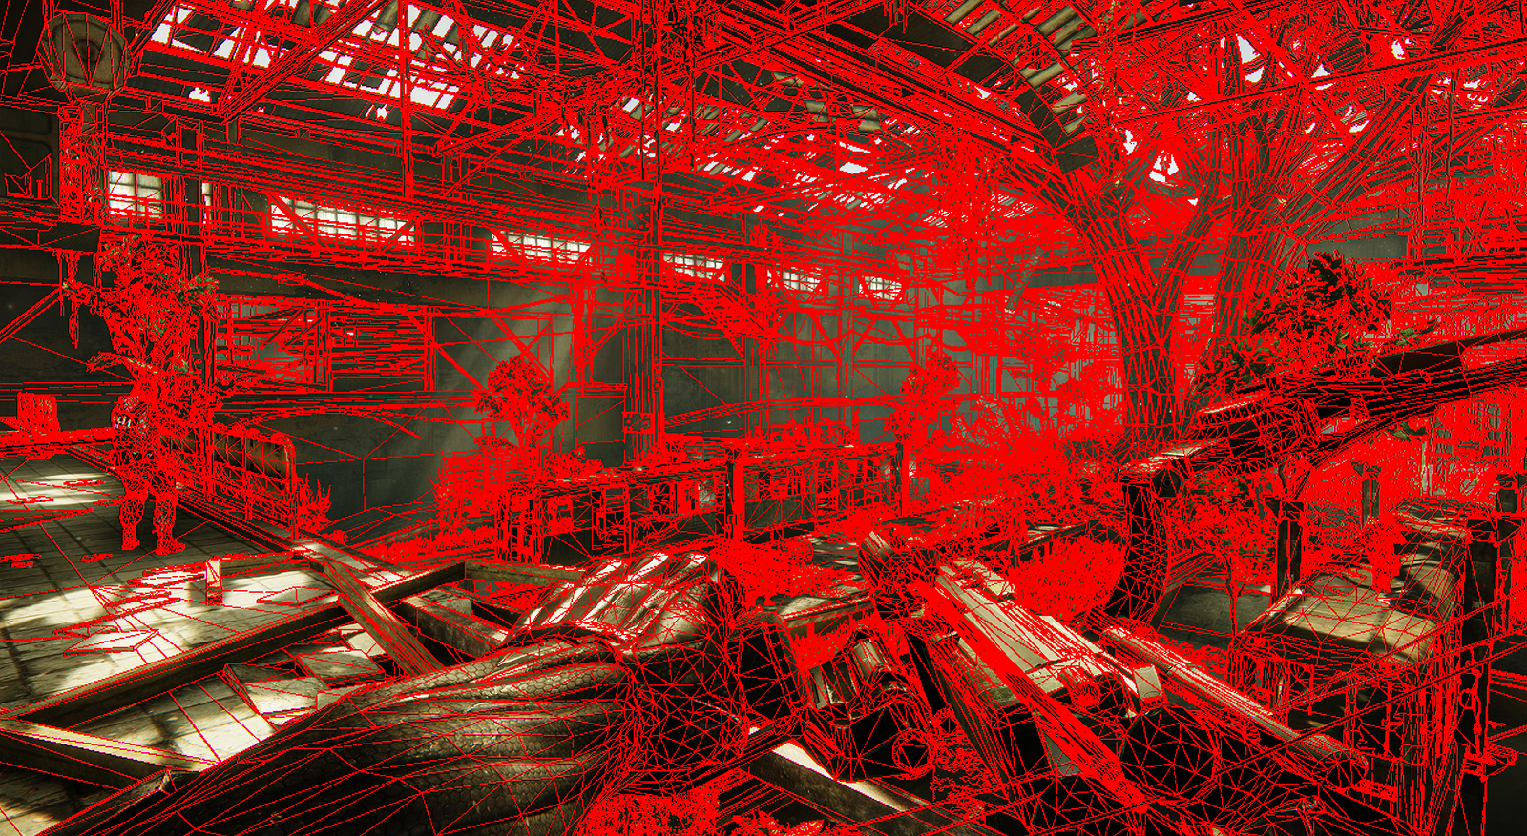
SV_Coverage

Slide 46
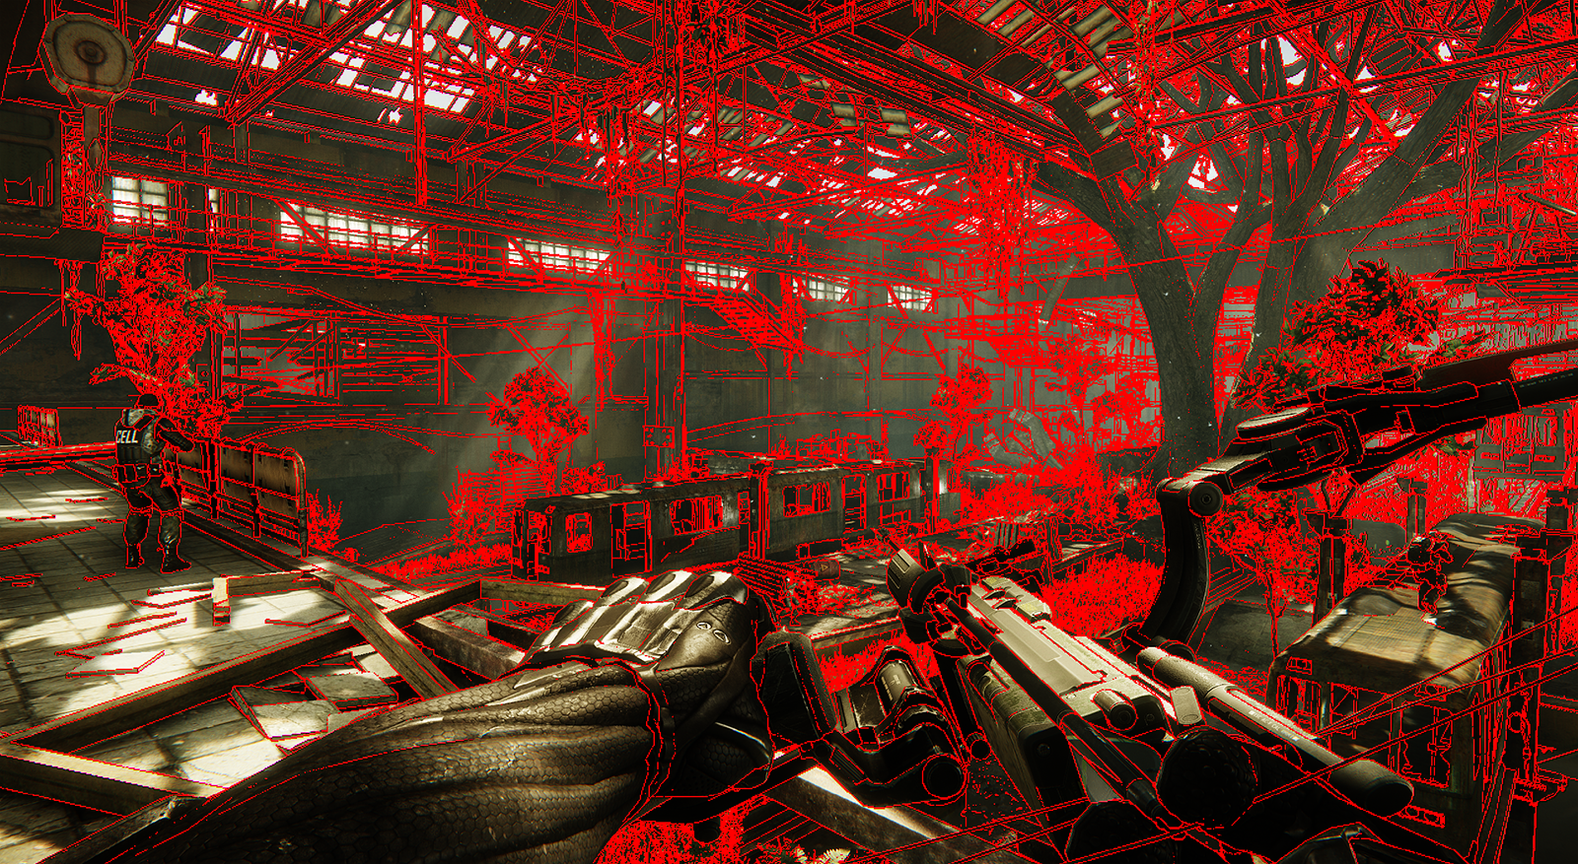
Custom Per-Sample Mask
Notes:
Custom Per-Sample Mask rejecting similar samples, via depth/normal threshold
One adittional little trick we also do: tag entire quad instead of just pixel, from our profiling helps stencil culling efficiency (due to better spatial coeherency => entire quad rejected/accepted) – in average about 1ms save

Slide 47
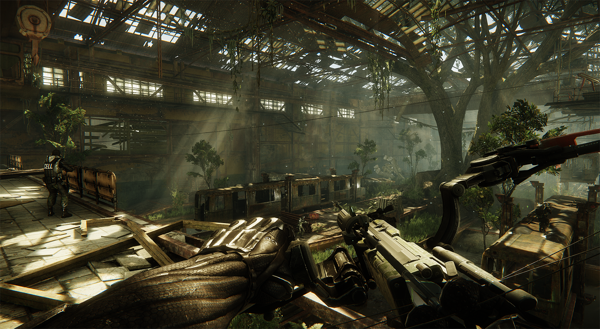
Final Result

Slide 48
Pixel/Sample Frequency Passes
Ensure disabling sample bit override via stencil write mask
StencilWriteMask = 0x7F
Pixel Frequency Passes
Set stencil read mask to reserved bits for per-pixel regions (~0x80)
Bind pre-resolved (non-multisampled) targets SRVs
Render pass as usual
Sample Frequency Passes
Set stencil read mask to reserved bit for per-sample regions (0x80)
Bind multisampled targets SRVs
Index current sub-sample via SV_SAMPLEINDEX
Render pass as usual

Slide 49
Alpha Test Super-Sampling
Alpha testing is a special case
Default SV_Coverage only applies to triangle edges
Create your own sub-sample coverage mask
E.g. check if current sub-sample AT or not and set bit
// 2 thumbs up for standardized MSAA offsets on DX11 (and even documented!) static const float2 vMSAAOffsets[2] = {float2(0.25, 0.25),float2(-0.25,-0.25)}; const float2 vDDX = ddx(vTexCoord.xy); const float2 vDDY = ddy(vTexCoord.xy); [unroll] for(int s = 0; s < nSampleCount; ++s) { float2 vTexOffset = vMSAAOffsets[s].x * vDDX + vMSAAOffsets[s].y * vDDY; float fAlpha = tex2D(DiffuseSmp, vTexCoord + vTexOffset).w; uCoverageMask |= ((fAlpha-fAlphaRef) >= 0)? (uint(0x1)<<i) : 0; }
Notes:
(Tip from Thibieroz) EvaluateAttributeAtSample vs DDX/DDY – DDX/Y are TEX intructions, using EvaluateAttribute will likely perform better

Slide 50
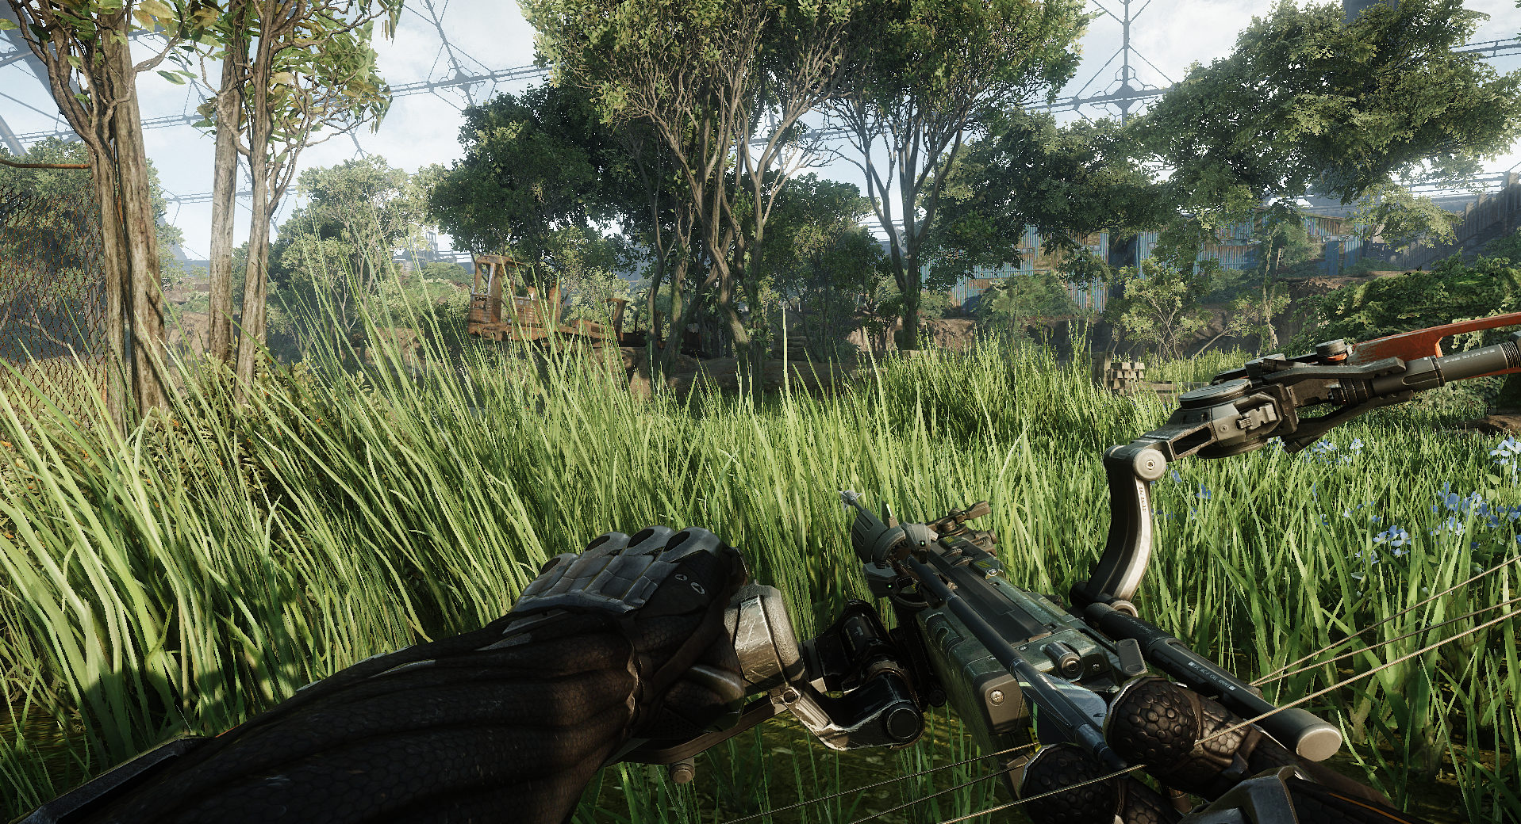
Alpha Test Super-Sampling
Alpha Test SSAA Disabled

Slide 51
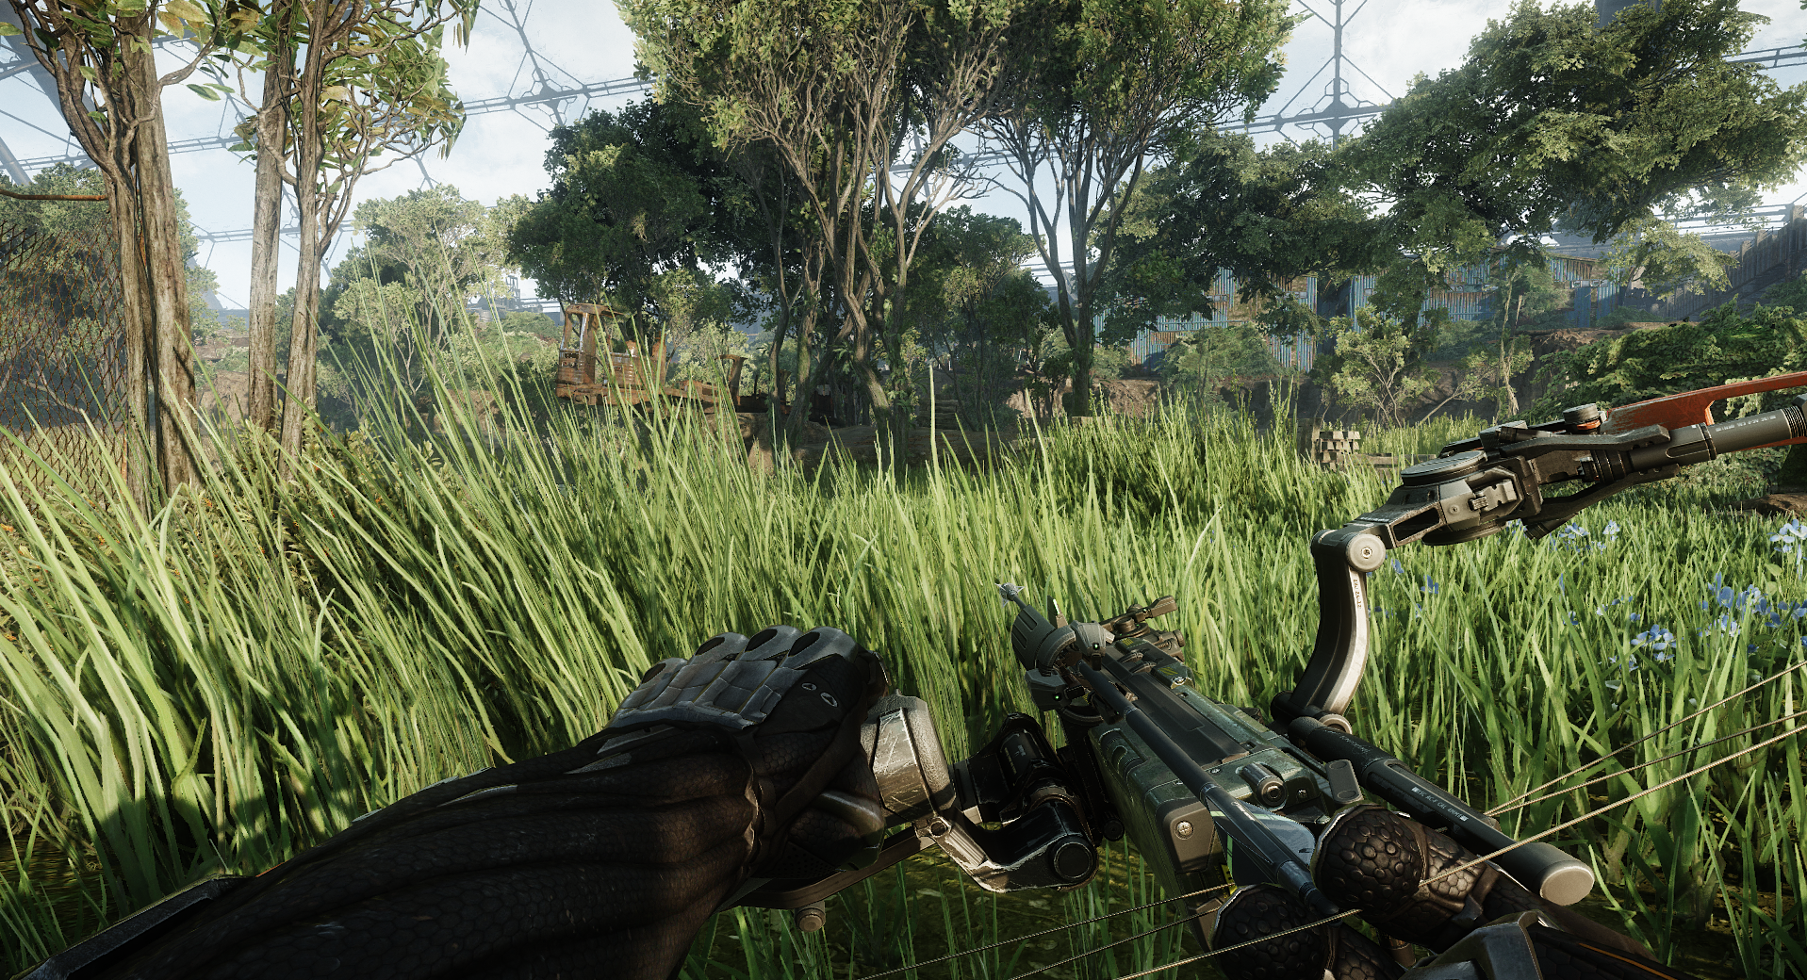
Alpha Test Super-Sampling
Alpha Test SSAA Enabled

Slide 52
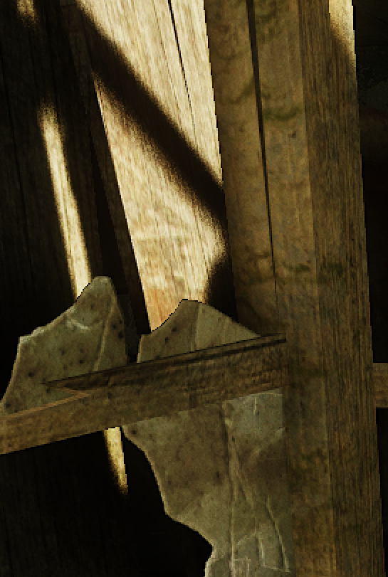

Corner Cases
Cascades sun shadow maps:
Doing it “by the book” gets expensive quickly
Render shadows as usual at pixel frequency
Bilateral upscale during deferred shading composite pass
Notes:
Motion blur and Depth of Field
Both done at pixel frequency
Composited into MSAA buffer after

Slide 53
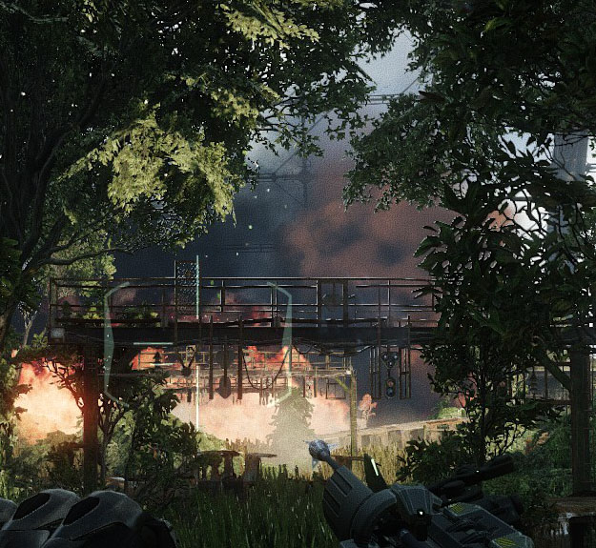

Corner Cases
Soft particles (or similar techniques accessing depth):
Recommendation to tackle via per-sample frequency is quite slow on real world scenarios
Max Depth instead works quite ok for most cases and N-times faster
Bad
Good
Notes:
Motion blur and Depth of Field
Both done at pixel frequency
Composited into MSAA buffer after

Slide 54
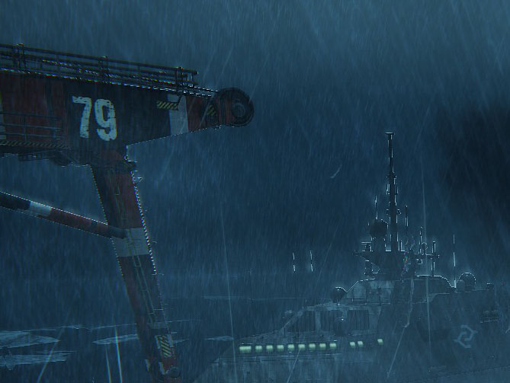
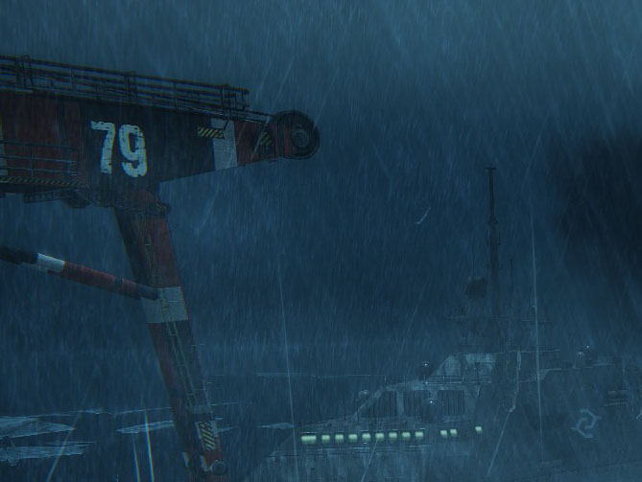
MSAA Friendliness
MSAA unfriendly techniques, the usual suspects:
No AA at all or noticeable bright/dark silhouettes
Bad
Good

Slide 55
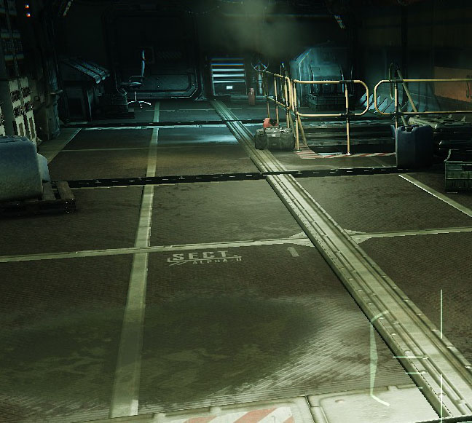
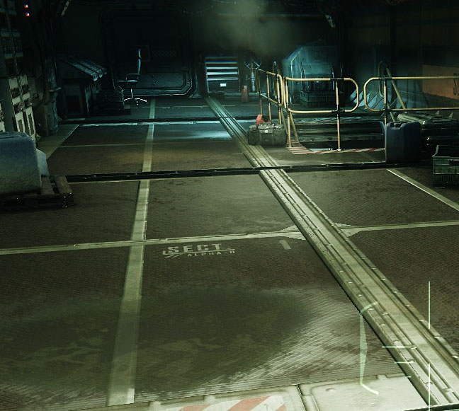
MSAA Friendliness
MSAA unfriendly techniques, the usual suspects:
No AA at all or noticeable bright/dark silhouettes
Bad
Good

Slide 56
MSAA Friendliness
Rules of thumb:
Accessing and/or rendering to Multisampled Render Targets?
Then you’ll need to care about accessing/outputting correct sub-sample
Obviously, always minimize BW – avoid fat formats
The later is always valid, but even more for MSAA cases

Slide 57
MSAA Correctness vs Performance
Our goal was correctness and quality over performance
You can always cut some corners as most games doing:
Alpha to Coverage instead of Alpha Test Super-Sampling
Or even no Alpha Test AA
Render only opaque with MSAA
Then render alpha blended passes withouth MSAA
Assuming HDR rendering: note that tone mapping is implicitly done post-resolve resulting is loss of detail on high contrast regions
Note to IHVs: Having explicit access to HW capabilities such as EQAA/CSAA would be nice
Smarter AA combos

Slide 58
Conclusion
What’s next for CryENGINE ?
A Big Next Generation leap is finally upon us
In 2 years time, GPUs will be at ~16 TFLOPS and ridiculous amount of available memory.
Extrapolate results from there, without >8 year old consoles slowing progress ☺
4k resolution will bring some interesting challenges/opportunities
Call to arms - still a lot of problems to solve
IHVs/Microsoft: PC GPU profilers have a lot to evolve! How about a unified GPU Profiler, working great for all IHVs?
Microsoft: Sup with DX11 (lack of) documentation? Where’s DX12?
You: No great realtime GI / realtime reflections solution yet!

Slide 59
Special Thanks
Nicolas Thibieroz
Chris Auty, Carsten Wenzel, Chris Raine, Chris Bolte, Baldur Karlsson, Andrew Khan, Michael Kopietz, Ivo Zoltan Frey, Desmond Gayle, Marco Corbetta, Jake Turner, Pierre-Ives Donzallaz, Magnus Larbrant, Nicolas Schulz, Nick Kasyan, Vladimir Kajalin..
Uff… lets just make it shorter:
Thanks to the entire Crytek Team ^_^

Slide 60
Questions?
Tiago@Crytek.com / Twitter: Crytek_Tiago
Carsten@Crytek.com
ChristopherR@Crytek.com / Twitter: Cry_Raine

Slide 61

Where are hiring !

Slide 62
References
WENZEL06 – Wenzel, C. “Real-time Atmospheric Effects in Games”, 2006
JESCHKE07 - Jeschke, S. et al. “Interactive Smooth and Curved Shell Mapping”, 2007
THIBIEROZ08 – Thibieroz, N. “Deferred Shading with Multisampling Anti-Aliasing in DirectX10”, 2008
TÓTH09 – Tóth, B. et al. “Real-time Volumetric Lighting in Participating Media”, 2009
SOUSA11 - Sousa, T. “CryENGINE 3 Rendering Techniques”, 2011
McDONALD12 – McDonald, J. “Don’t Throw it all Away”, 2012
WIKI00 – “Stereographic projection”, http://en.wikipedia.org/wiki/Stereographic_projection
WIKI01 – “Y’CbCr”, http://en.wikipedia.org/wiki/YCbCr
WIKI02– “Chroma subsampling”, http://en.wikipedia.org/wiki/Chroma_subsampling

Slide 63
Extra Slides

Slide 64
Massive Grass: Challenges
Trick: Updating allocation done with Copy-On-Write in case GPU still using original location
Consoles: incrementally defragment pools with GPU memory copies
Also possible on PC, but more expensive due to CopySubResource limitations (need scratchpad memory, since CSR won’t allow copies where Dst/Src are same resource)
Note to IHVs: Being able to copy from same Dst/Src resource, if non-overlapping memory regions, would be handy
Ended up using allocation & usage scheme for static geometry as well

